Slide 1
Calculator Section
How to use your electronic brain

Slide 2
Key Points
Use Templates as much as possible
Use Brackets
Use Table
Try to do just one calculation
The ANS button recalls the last answer
Find the Standard Form button

Slide 3
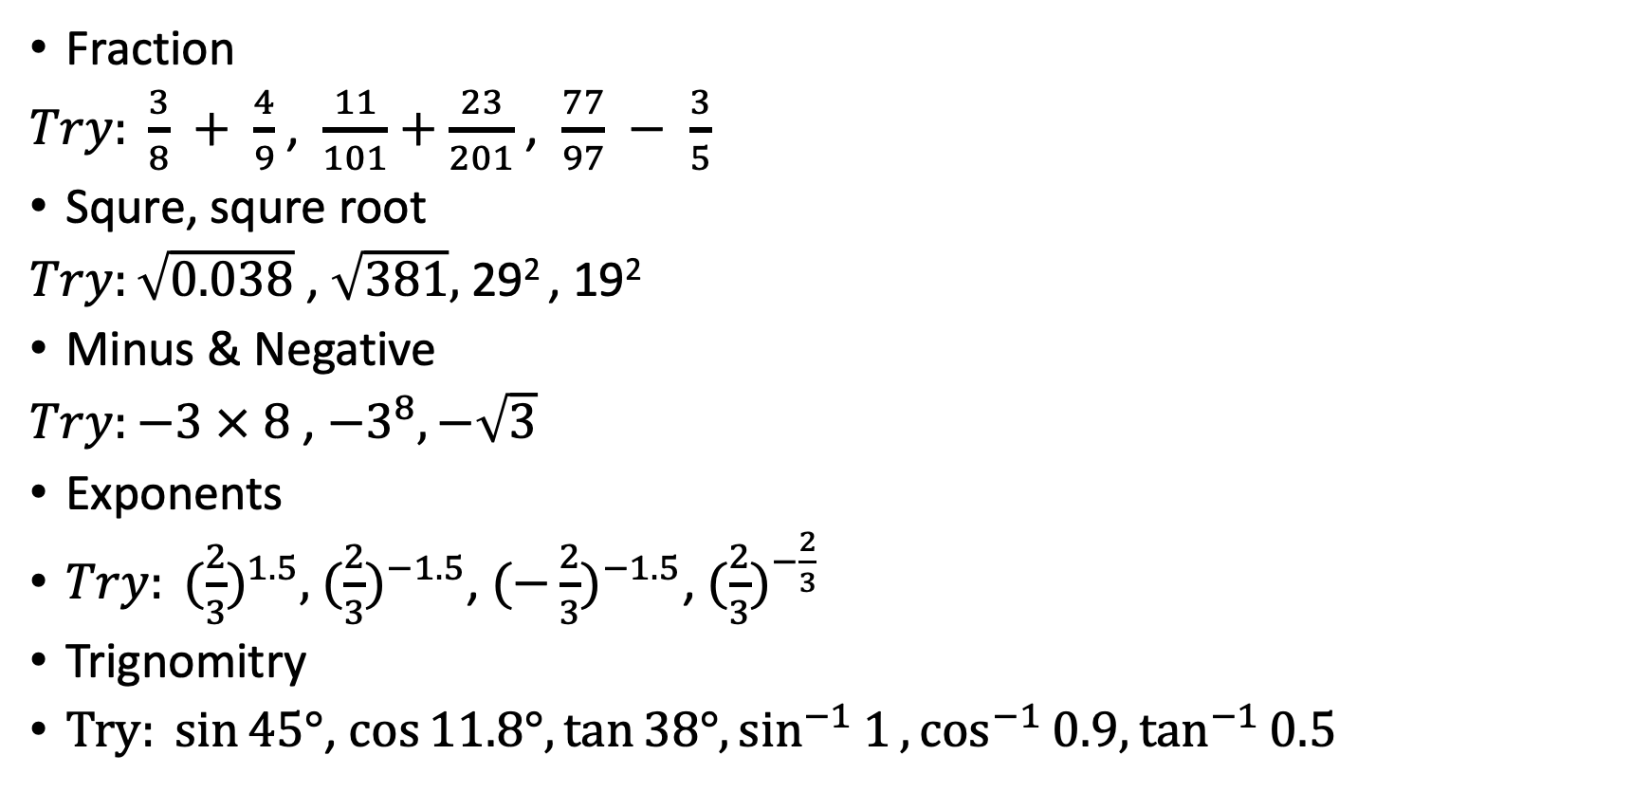
Template
Fraction
$Try: \frac{3}{8} + \frac{4}{9}$ , $\frac{11}{101}+\frac{23}{201}$ , $\frac{77}{97} − \frac{3}{5}$
Squre, squre root
$Try:\sqrt{0.038}$ , $\sqrt{381},$ 29² , 19²
Minus & Negative
$Try:−3 × 8$ , ${−3}^{8}, −\sqrt{3}$
Exponents
${Try: (\frac{2}{3})}^{1.5},$ ${(\frac{2}{3})}^{−1.5}$, ${(−\frac{2}{3})}^{−1.5}$, ${(\frac{2}{3})}^{−\frac{2}{3}}$
Trignomitry
$Try: sin{45°}$, $\cos{11.8°,}\tan{38°,}\sin^{−1}{1},\cos^{−1}{0.9,}\tan^{−1}{0.5}$

Slide 4
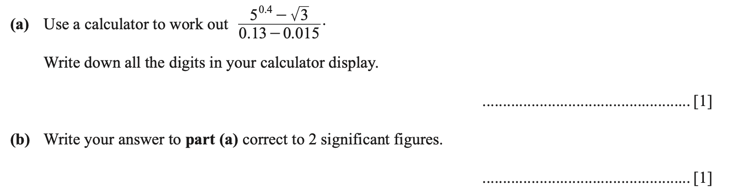
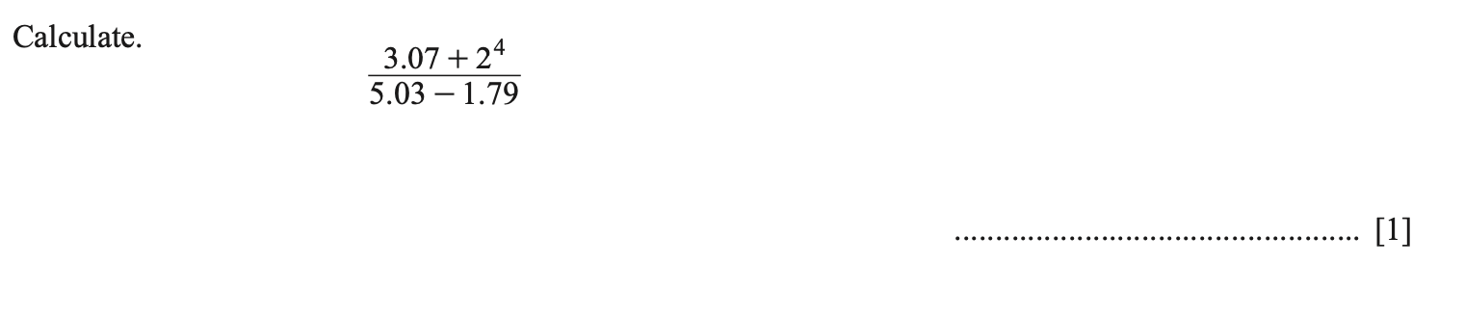
Use Brackets

Slide 5
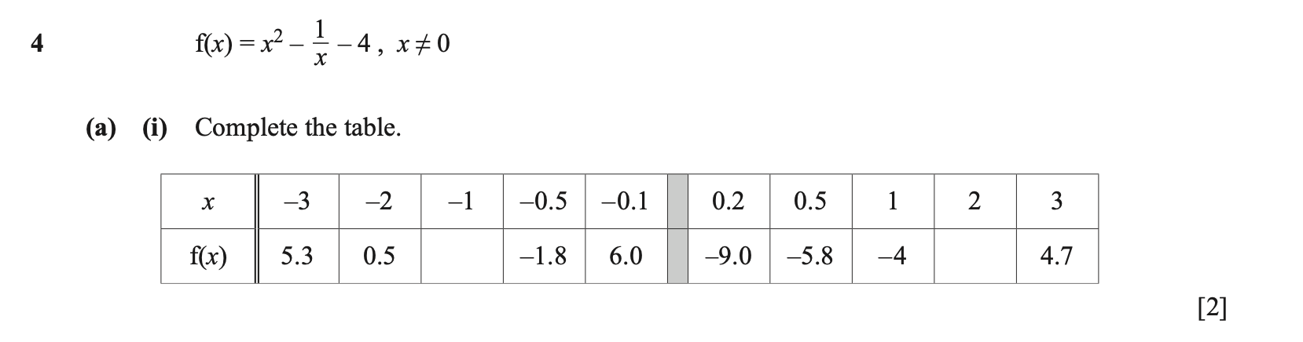
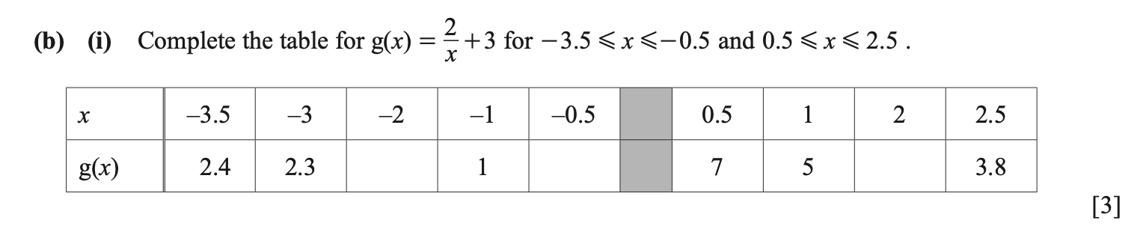
Use Table

Slide 6
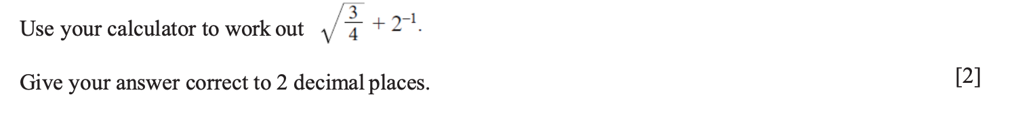
Try to do one calculation

Slide 7
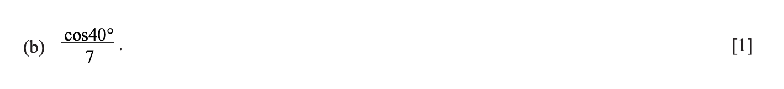
The ANS button recalls the last answer

Slide 8
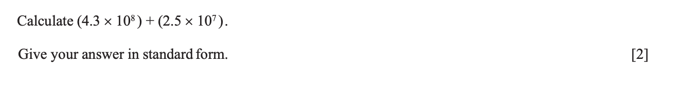
Standard Form
$$2×9.7×{10}^{−6}$$

Slide 9
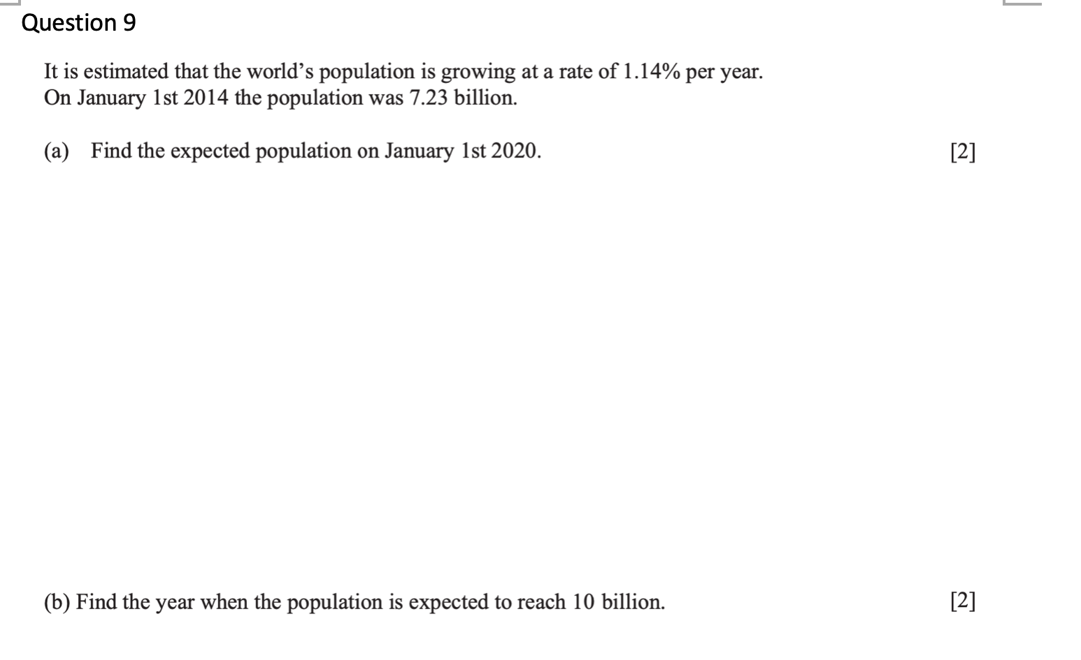

Slide 10
